Slide 1
Human Resource management system
Shams Bin Nahin

Slide 2
Overview
ABSTRACT
We based our project on Human Resource Management System.
DESIGN
The Project has been solely designed on Oracle.
Key features
Employee Information
Payroll Management
Employee’s Leave Database
Manipulation of different Data
Relational Database

Slide 3
H-R Management System
Human Resource Management Systems (HRMS) play a crucial role in streamlining and optimizing employee-related processes within organizations. A human resource management system (HRMS) is a software application that simplifies and automates human resource (HR) tasks, such as payroll, recruiting, and performance management. HRMS solutions help organizations streamline HR processes, improve employee productivity, and enhance compliance with labor laws. They also provide HR professionals with valuable data and insights to make informed decisions about talent management and workforce planning.
Why Oracle?
Oracle Database, a powerful and scalable relational database management system (RDBMS), serves as a robust foundation for building and implementing effective HRMS solutions.
Key Benefits of Using Oracle Database for HRMS:
Scalability and Performance: Oracle Database can handle large volumes of HR data, including employee records, payroll information, and performance metrics, ensuring seamless operations even as the organization grows.
Reliability and Security: Oracle Database is renowned for its reliability and data integrity, safeguarding sensitive employee information from unauthorized access and ensuring system availability.
Integration and Customization: Oracle Database integrates seamlessly with other enterprise applications, such as ERP and CRM systems, enabling data exchange and holistic business management.
Cost-Effectiveness and Scalability: Oracle Database offers flexible licensing options and scalable infrastructure, making it a cost-effective and scalable solution for organizations of all sizes.

Slide 4
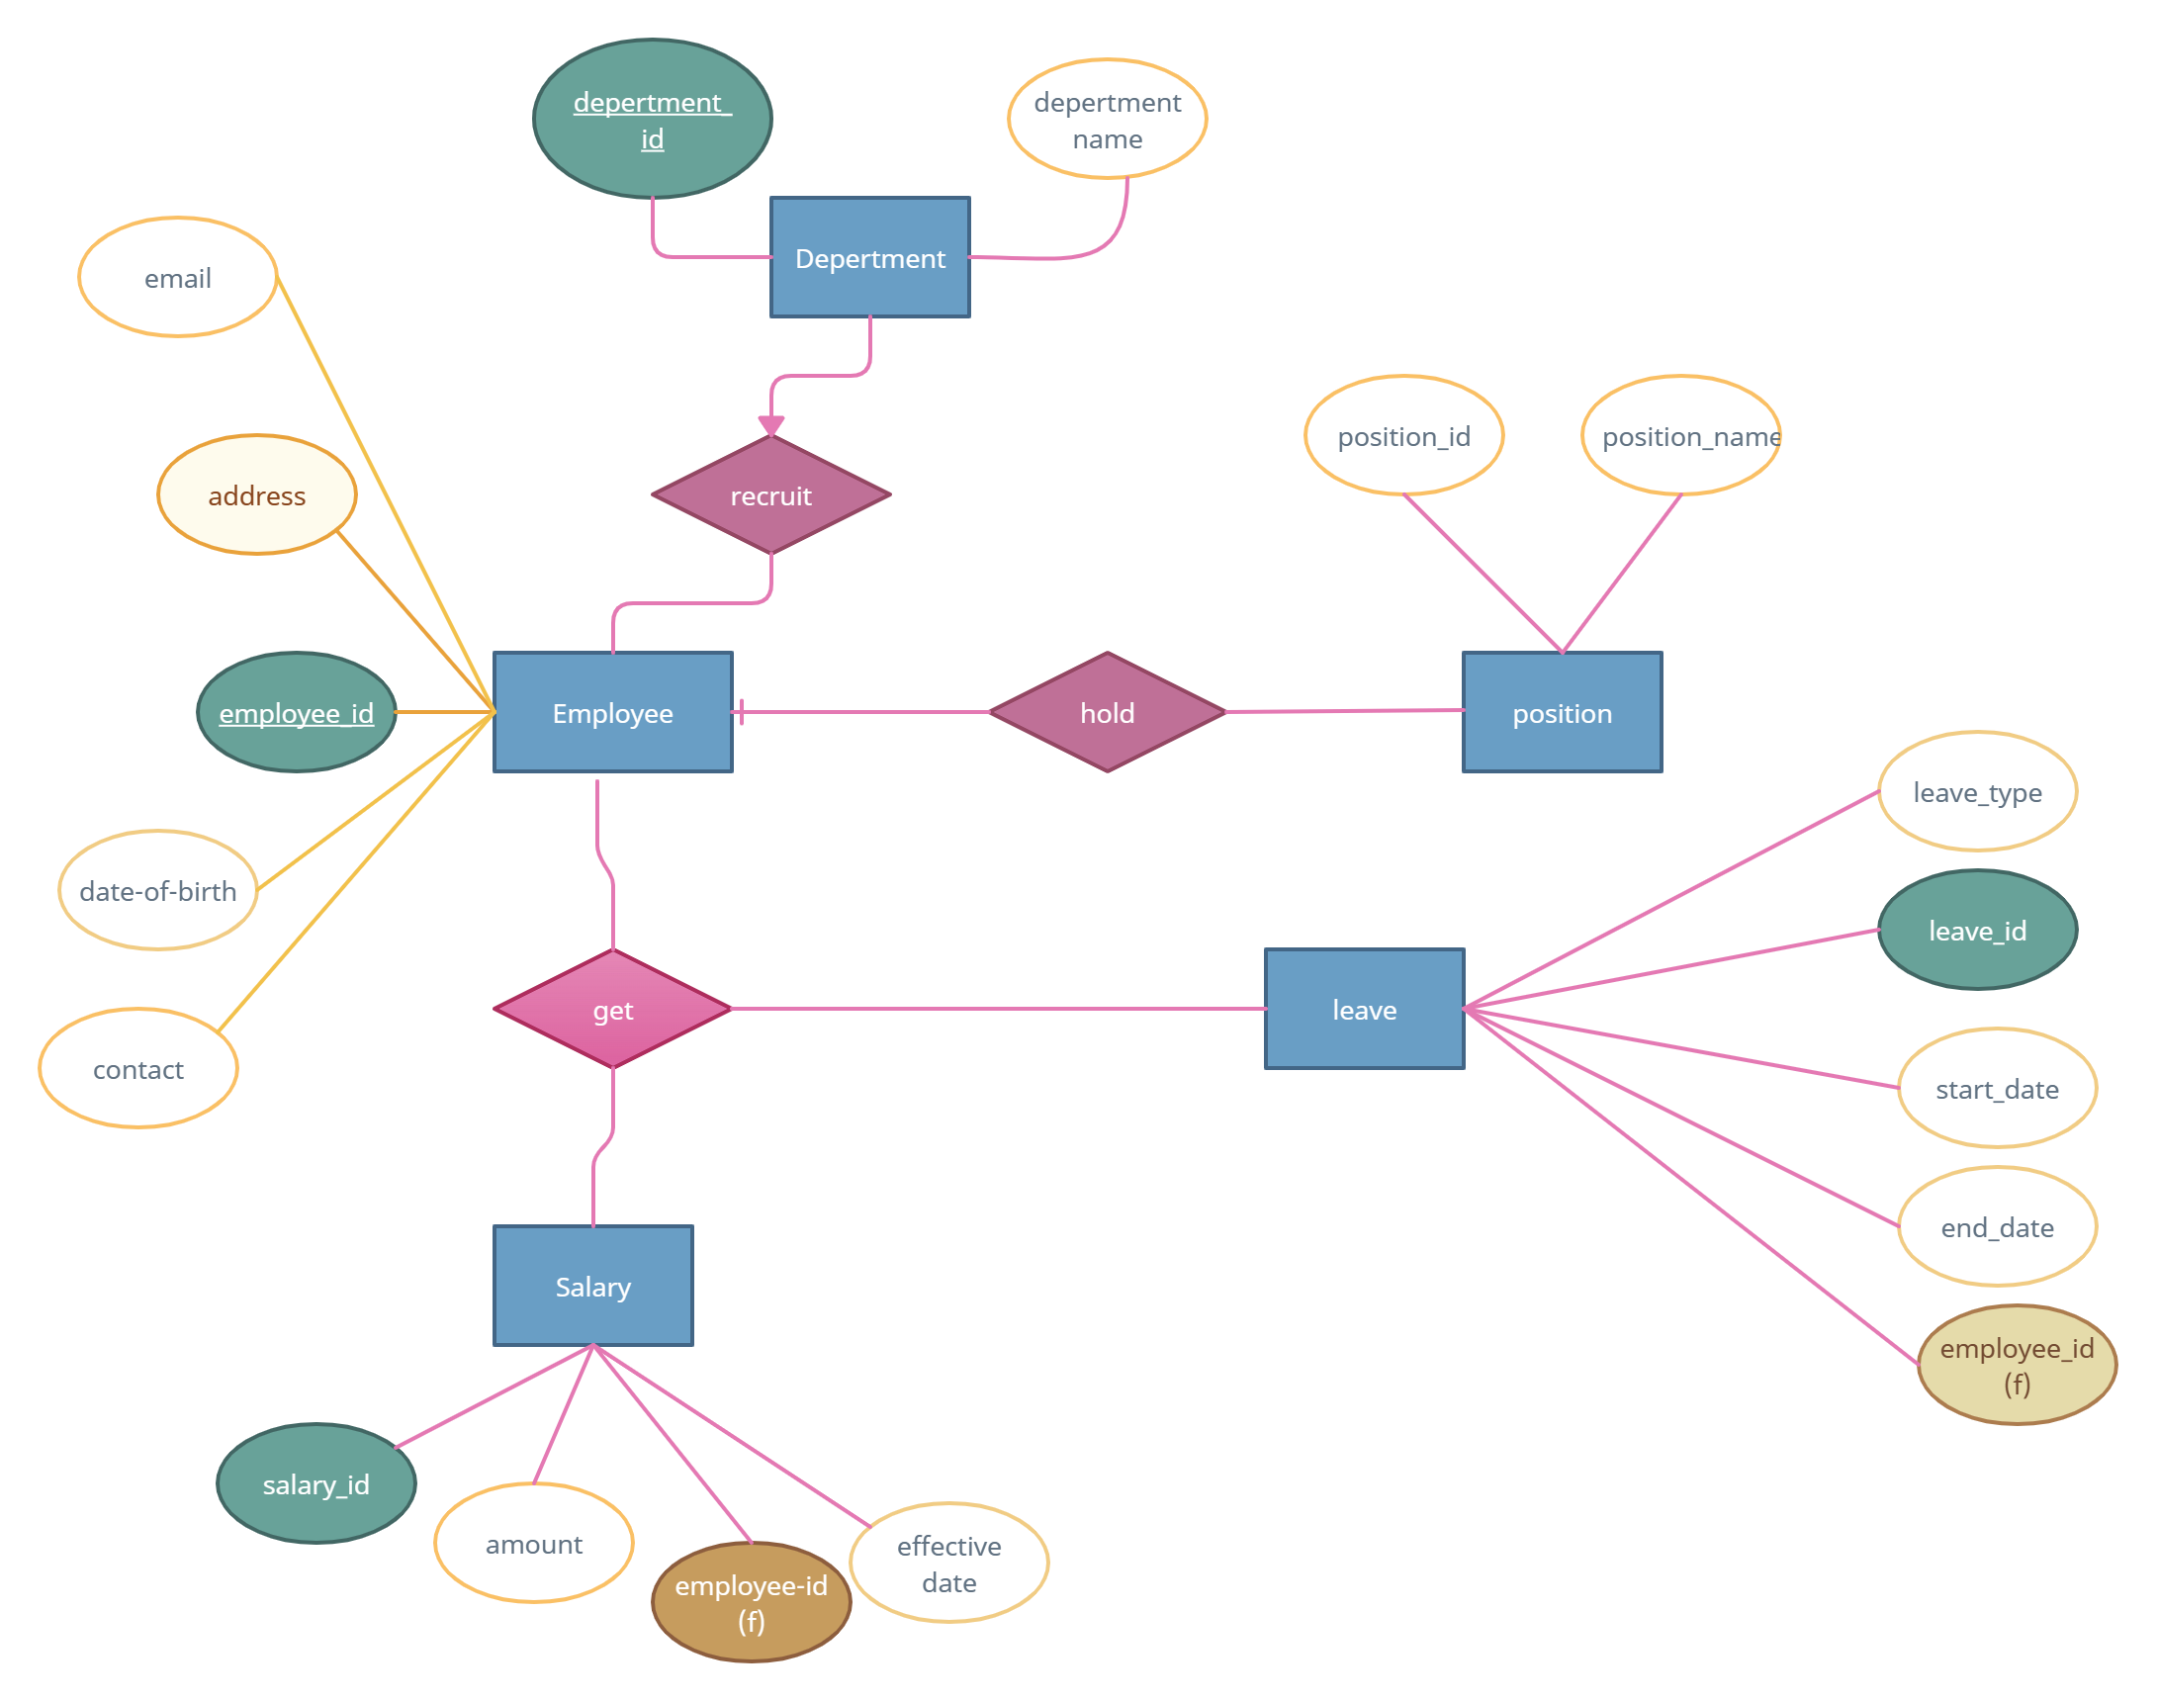
E-R diagram
E-r diagram

Slide 5
The Entity-Relationship (ER) diagram can be described as follows:
Department Entity:
Attributes: department_id (Primary Key), department_name.
Position Entity:
Attributes: position_id (Primary Key), position_name.
Represents various job positions available within the organization.
Employee Entity:
Attributes: employee_id (Primary Key), first_name, last_name, date_of_birth, gender, contact_number, email_address.
Foreign Keys: department_id (references department( department_id)), position_id (references position(position_id)).
Represents individual employees and their associated information, with relationships to departments and positions.
Salary Entity:
Attributes: salary_id (Primary Key), employee_id (Foreign Key references employee(employee_id)), salary_amount, effective_date.
Represents the salary details of employees at specific effective date.
Leave Entity:
Attributes: leave_id (Primary Key), employee_id (Foreign Key references employee(employee_id)), leave_type, start_date, end_date, reason, status.
Represents leave requests submitted by employees, including type, duration, reason, and status.

Slide 6
Tables and entity relationship model

Slide 7
Department
Position
Department id | Department Name
1 | HR
2 | Finance
3 | IT
4 | Operations
5 | Marketing
6 | Administration
7 8 9 | Research Sales Customer Service
Position id | Position Name
1 | Manager
2 | Supervisor
3 | Executive
4 | Associate
5 | Analyst
6 | Coordinator
7 | Administrator

Slide 8
Employee
Employee id | Name | Date of Birth | Gender | Contact No | Email | Dept. Id | Position Id | Address
1 | Nahin Shams | 09-04-2001 | Male | 01763101993 | nahin@gmail.com | 3 | 5 | 123,Ulipur , Kurigram
2 | Nishat Taaha | 5-07-2001 | Female | 01763101993 | taaha@gmail.com | 2 | 4 | 456 Mirpur, Dhaka',
3 | Sanjukta | 3-02-2001 | Female | 01763101993 | san@gmail.com | 4 | 6 | 789 Shat Rasta, Khulna
4 | Marjan | 4-05-1997 | Male | 01763101993 | jan@gmail.com | 7 | 2 | 654,Sheorapara, Dhaka
5 | Joita | 18-5-2000 | Female | 01763101993 | joye@gmail.com | 6 | 1 | 987 Uttara, Dhaka
6 | Shupto | 30-9-1997 | Male | 01763101993 | Ishq@gmail.com | 1 | 3 | 852,Peshwar, Khaibarpakhtun
7 | Emilie | 07-08-1997 | Female | 01763101993 | emee@gmail.com | 5 | 7 | 456 Dublin, Dublin',

Slide 9
Salary
Salary id | Employee id | Salary amount | Effective date
1 | 3 | 60000 | 05-01-24
2 | 4 | 50000 | 05-01-24
3 | 2 | 45000 | 05-01-24
4 | 1 | 38000 | 05-01-24
Leave
Leave id | Employee id | Leave type | Start date | End date | Reason | status
1 | 3 | Sick | 023-07-15 | 023-07-15 | Flu | Pending
2 | 5 | Marriage | 023-07-15 | 023-07-15 | Marriage | Approved
3 | 4 | Sick | 023-07-15 | 023-07-15 | Fever | Pending
4 | 1 | Vacation | 023-07-15 | 023-07-15 | Family reunion | Approved

Slide 10

THANK YOU
Md. Shams Bin Nahin
Roll. 19090001
Dept. ECE
Year. 3rd Term. 2nd

